Slide 1
Software and Systems Deck
Content and Illustrations

Slide 2
Overview slide
The KOKO networks product suite provides all the software tools and systems required for licensees to run a KOKO network in any country. The key products which compose the software suite are depicted in the diagram and are grouped into 5 packages:
Customer Package: A suite of applications to enable end customer interaction. Customers engage with KOKO through the KOKOpoint interface, KOKO Fuel’s website and the myKOKO app on their smartphones.
KSPS Package: An end to end financial accounting, reporting and compliance software suite to manage bookkeeping, back office operations and settlements with partners such as agents, fuel suppliers and regulatory authorities. The package also has the ability to make automated scheduled payments.
Stove distribution & Maintenance Package: A suite of mobile applications to manage warehousing and distribution of cookers using smart route and capacity optimisation algorithms to ensure cost effective deliveries. The maintenance feature set allows for tracking of parts and tools during repair and maintenance activities.
Fuel logistics Package: A plug and play toolkit that allows downstream fuel wholesale partners to utilise their infrastructure to deliver ethanol fuel to KOKO Agents in a secure and seamless manner
Agent Management Package: A customised CRM toolkit with accompanying field service inspection and sales mobile apps to build an agent network from scratch and help agents who sign up to the KOKO franchise engage with KOKO and manage their franchise.
Insights Package: A robust reporting infrastructure which aggregates key network metrics across all data sources and integrates with a range of visualisation tools to provide descriptive and predictive analytics.
All the above packages are seamlessly integrated and orchestrated by a proprietary cloud application called KOKO Core.

Slide 3
Core Platform
The KOKO Networks Core Engine is the heart of the software application suite that runs in the cloud. Its main responsibilities are to:
Control all KOKO Networks infrastructure and operations
Maintain the central data repository for a country network
Ensure all package applications work together seamlessly and securely.
Interface with third party systems such as SMS and payment gateways, CRM and financial accounting tools.
Supply KOKO’s analytics platform with raw data, which is used to create outputs that can be used to take decisions on operations and strategy
Seamlessly integrates with Odoo Core which powers our ERP applications
The Core Engine is built as a python application using a lightweight web framework called flask and connects to a Postgres database through an ORM layer provided by SQL Alchemy. The application is hosted on an Amazon Web Services cloud to ensure high availability at all times. Our application resides within a VPC (Virtual private cloud) to ensure secure access to our servers and we use SSL certificates to secure all network communications with the application, among other security measures.

Slide 4
Customer - myKOKO
Description
Through myKOKO customers are able to enhance their experience and get more from their relationship with KOKO Networks. It allows any new or existing user to get access to their account with KOKO, make an order for a stove, view savings progress and statements, and share credit with friends. An innovative referral program within myKOKO called KOKO Ambassador, allows them to earn money for bringing friends and family to KOKO. Other localised and personalised features and promotions of value to customers are regularly provided to keep users coming back to the app and derive more value from the KOKO Networks brand and experience.
Solution / System
myKOKO is a native android application, optimised for the range of phones commonly available in KOKO’s target markets, downloadable from the Google Play Store in Kenya. myKOKO is full integrated with our ERP and KOKO Core to allow order creation and ensure up to date product and customer account information.

Slide 5
Customer - myKOKO - suggested pics
We can keep same features as last time as only really been tweaks since last deck.
https://app.zeplin.io/project/5c8608aed09fc1389cc3d891/screen/5c86123fc927b438248ccf15
https://app.zeplin.io/project/5c8608aed09fc1389cc3d891/screen/5c8632b716ad1204682fef27
https://app.zeplin.io/project/5c8608aed09fc1389cc3d891/screen/5c8632dcdc2cc53873e87979

Slide 6
Customer - kokofuel.com
Description
The customer-facing website allows customers and agents to buy a cooker, learn about KOKO Fuel, learn about being a KOKO agent, view our KP network and log into their accounts. Kokofuel.com also enhances internet search presence, such that when customers first search KOKO they know what it is and how to access our products. Unlike apps, kokofuel.com is not android or IOS specific, and can be accessed on feature phones in addition to smartphones. The website is responsive but uses mobile first design so customers can easily look us up on mobile phones from anywhere.
Solution / System
Kokofuel.com sits on a Wordpress Content Management System (CMS) and integrates with the ERP and KOKO Core using a set of versioned APIs. The CMS allows internal users (e.g. the Marketing team) to update images and text without relying on the Engineering Team for software changes, granting greater freedom to shape our customer communications on an ongoing basis. APIs into KOKO Core allow us to create accounts and orders for customers, as well as serving the latest product information on the site. Payment for orders is done via the STK push integration with KOKO’s Safaricom MPESA till.

Slide 7
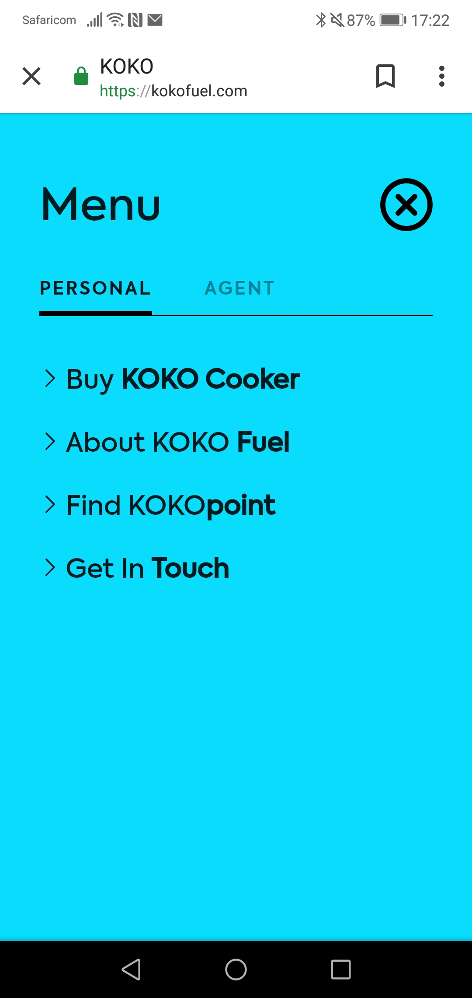
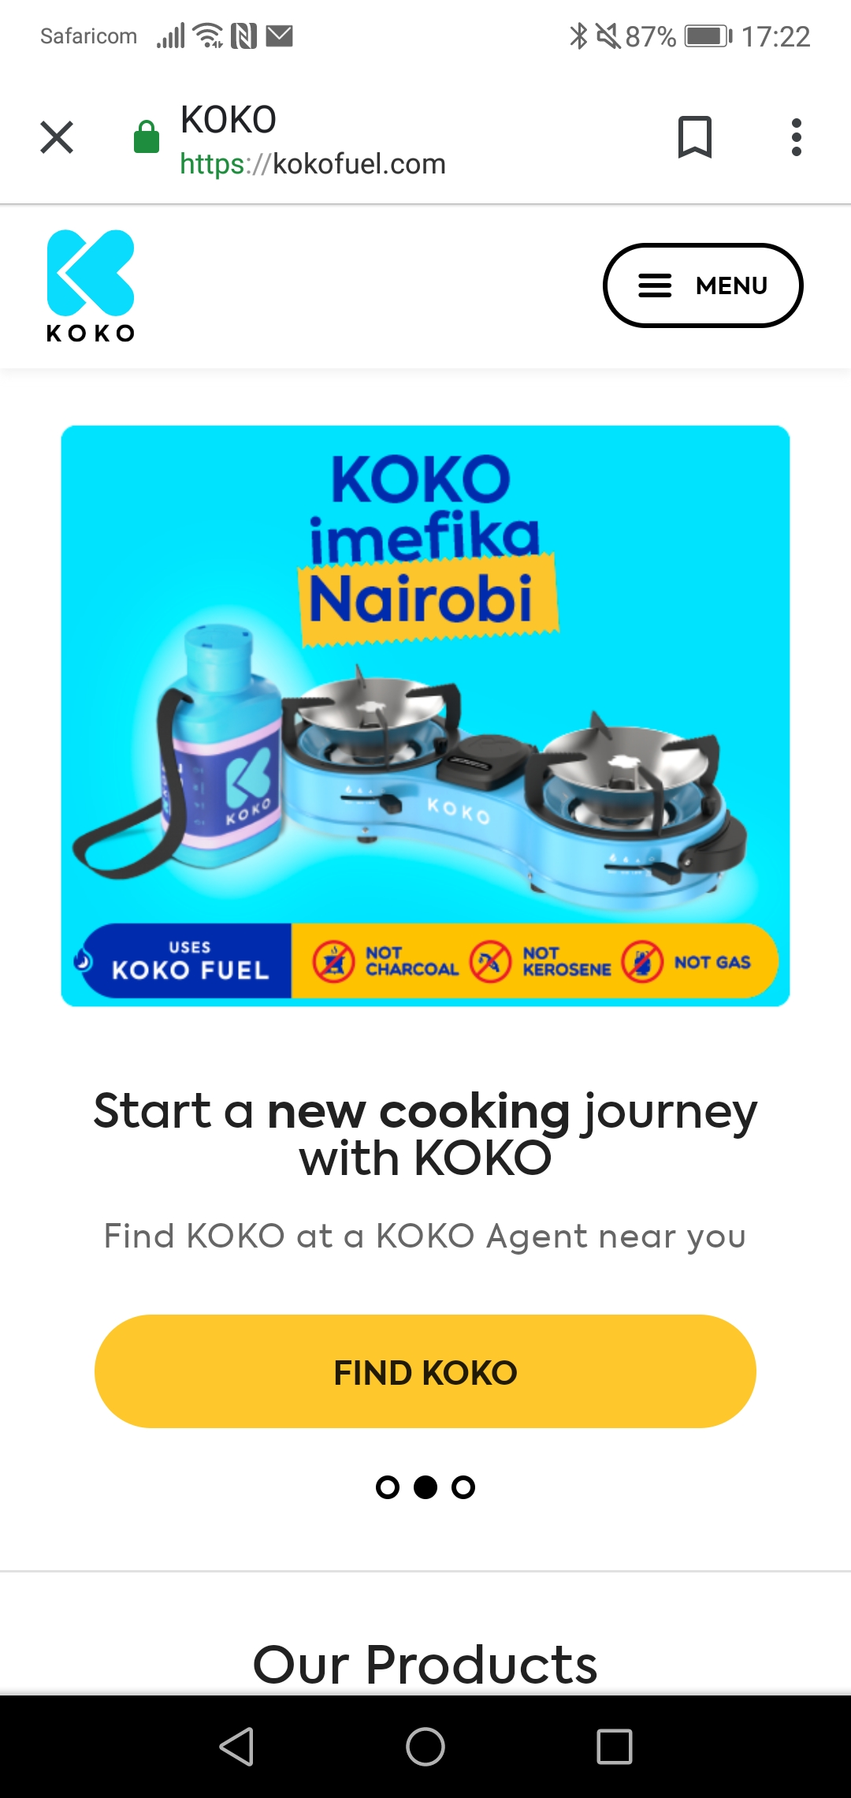
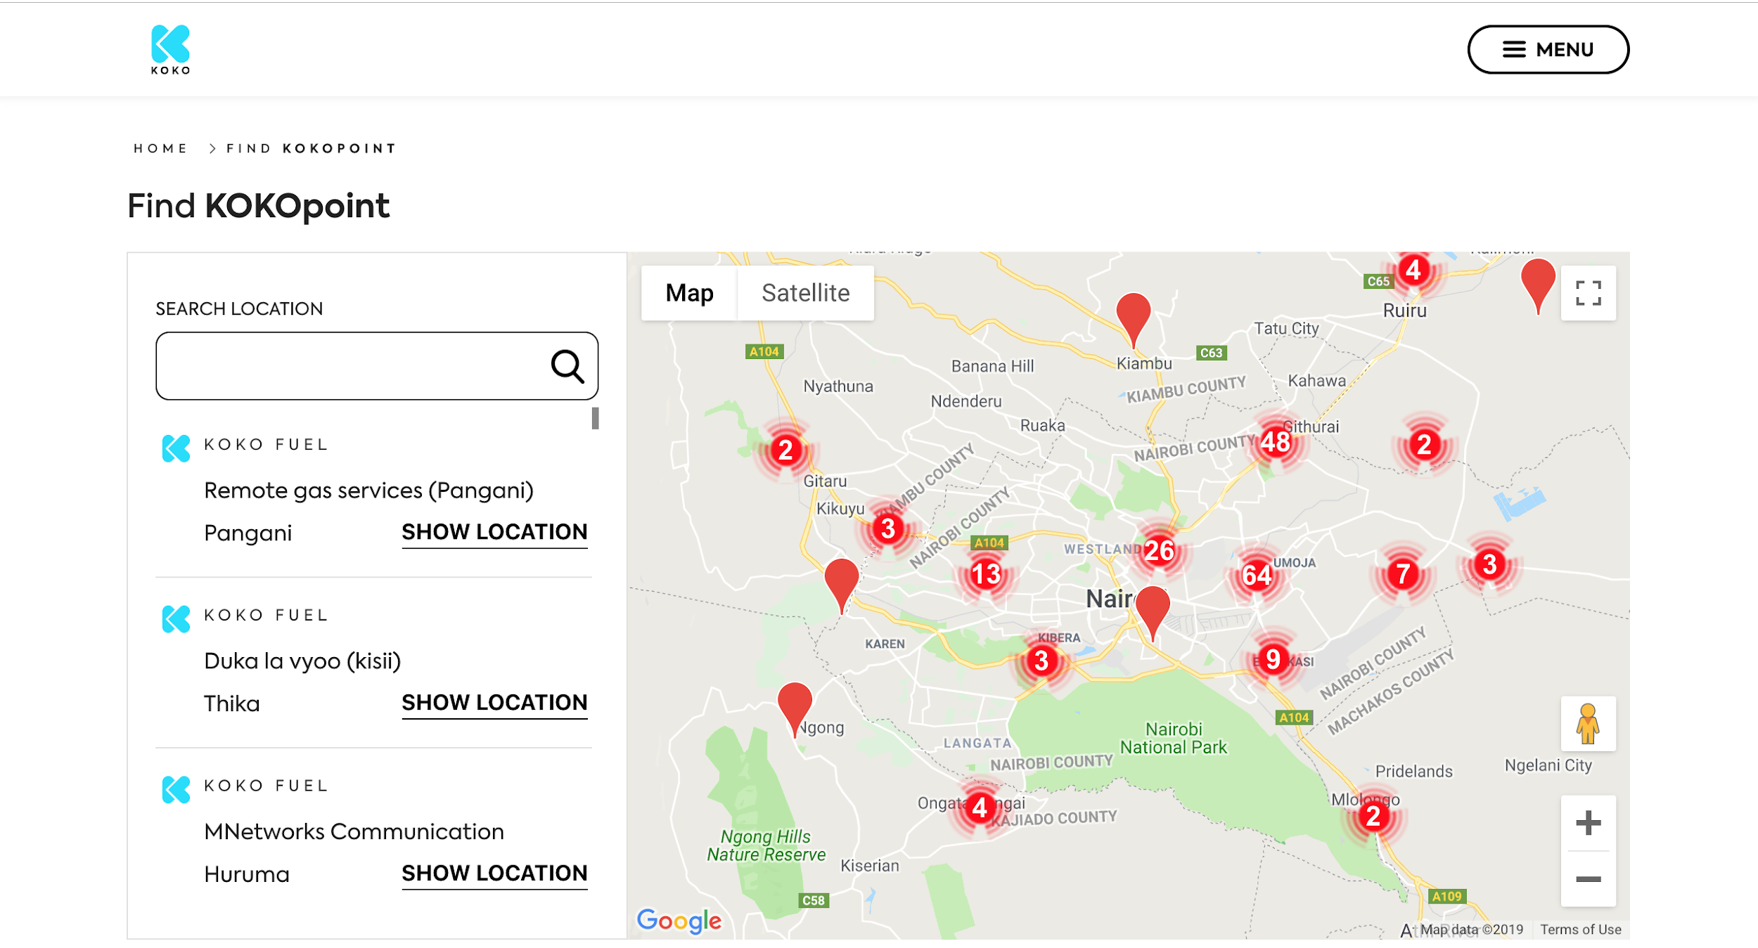
Customer - kokofuel.com - pics

Slide 8
Customer - KOKOpoint Application
The KOKOpoint is the main asset deployed by KOKO Networks. It is a secure, online and remotely monitored self-service kiosk, which dispenses KOKO Fuel. The KOKOpoint is installed in a highly visible location inside the agent premises and is always online, supported by a backup power system and 24/7 monitoring of the systems’ health sensors. The fuel itself is stored in a secure stainless steel tank, and dispensed using a precisely measured pump. Fuel is refilled via a key-less external access box, which connects to the top of the KOKOpoint allowing easy refilling on a regular basis. Fuel vapour is never released into the atmosphere when either refilling the KOKOpoint or a customer canister, since vapour rich air from either the tank or canister respectively is returned to the filling vessel through an air return valve. The KOKOpoint has a proprietary embedded control system, designed and built by KOKO Networks which manages the dispensation of fuel to customers and monitors the system’s safety and security.
The KOKOPoint app is a window into the world of KOKO which all customers see whenever they go to buy fuel. Customers can order their KOKO Cooker as well as other products, buy fuel, view their account details, access special offers from KOKO and third parties and learn more about KOKO through our engaging video content. In addition the KOKOPoint customer journey includes prime ad space, which reaches potential customers passing by a KP, as well as targeted ads for logged in users. There is also a maintenance interface which can be accessed by internal users performing activities such as calibration
Solution / System
The KOKOpoint software is a native Android application that runs on a hardware platform designed for kiosks, and connects to the KOKOpoint’s proprietary control system. Product info and order creation are facilitated by APIs into KOKO Core and the ERP. Videos, interactive content and static ads which sit on our Ads platform are served to the KP using webviews. The KOKOPoints can be updated remotely individually, in batches or network wide at once in a flexible but safe manner.

Slide 9
KP APP pictures
https://app.zeplin.io/project/5c81218b5421337ad5005cea/screen/5d1a36f1f9016254f519fb39
https://app.zeplin.io/project/5c81218b5421337ad5005cea/screen/5d1a2de256e48056fa9257fa
https://app.zeplin.io/project/5c81218b5421337ad5005cea/screen/5d1a2ded4c6aab7399ca1bbd

Slide 10
Ads pics
https://app.zeplin.io/project/5c81218b5421337ad5005cea/screen/5d1a2dde2e162f50db0e8735
https://app.zeplin.io/project/5c81218b5421337ad5005cea/screen/5d1a2e0bdcaf0c730ee2b406

Slide 11
Ads Content
Overview
KOKO Ads is a targeted ad serving platform which allows brands to capitalise on the captive time we get from our users when they are in the process of a fuel purchase. Brands can target customers based on region, time of day, demographics and incentivise them for interactions. They can create a variety of interactive campaigns on a self service portal. The platform supports multiple formats such as static banners, video ads, surveys and polls. The system performs extensive customer profiling in the background, collecting user data from various channels such as user demographics, location, fuel purchase behaviour etc. The KOKO Ads Platform can be leveraged across multiple channels e.g. the KOKOPoint, myKOKO and kokofuel.com
System/Solution
The application is built on top of a third party ad server, Ad butler which seamlessly integrates with our KOKOpoint systems and third party ad exchanges. Adbutler allows for the tracking of campaigns including impressions. Client Dashboards sitting on top of the ad serving platform allow our clients to view and analyse their campaigns and KPIs via an external website.
Customer targeting is achieved using a proprietary Data Management Platform (DMP) application built on python. The DMP has been built to import key customer and site attributes from KOKO Core and Odoo but also facilitates the addition of new sites and customers or changing of details.
Media (video files) are hosted on a Content Delivery Network (CDN) which allows for faster downloading of content from a closer server.

Slide 12
Cooker Manufacturing & Accounting
Overview
KOKO’s Cooker kits comprising of a cooker and NFC enabled canister are manufactured in a 65000 sq ft state of the art facility in India. To manage the production process we have implemented a customised ERP solution which manages key operations such as accounting, purchase management, manufacturing automation, inventory control, material handling and kit dispatches. It is also seamlessly integrated with our Cooker distribution softwares to ensure we have complete quality and distribution control over the kits right from the production assembly line till the customer’s homes.
Systems
The ERP system has been built using Odoo and integrates with a third party software, Tally, for managing local India compliances as well as our customised Odoo ERP in Kenya which can look up the NFC information for customer canisters from the production data and enables complete traceability for easier maintenance, repairs and warranty management of the cooker kits.

Slide 13
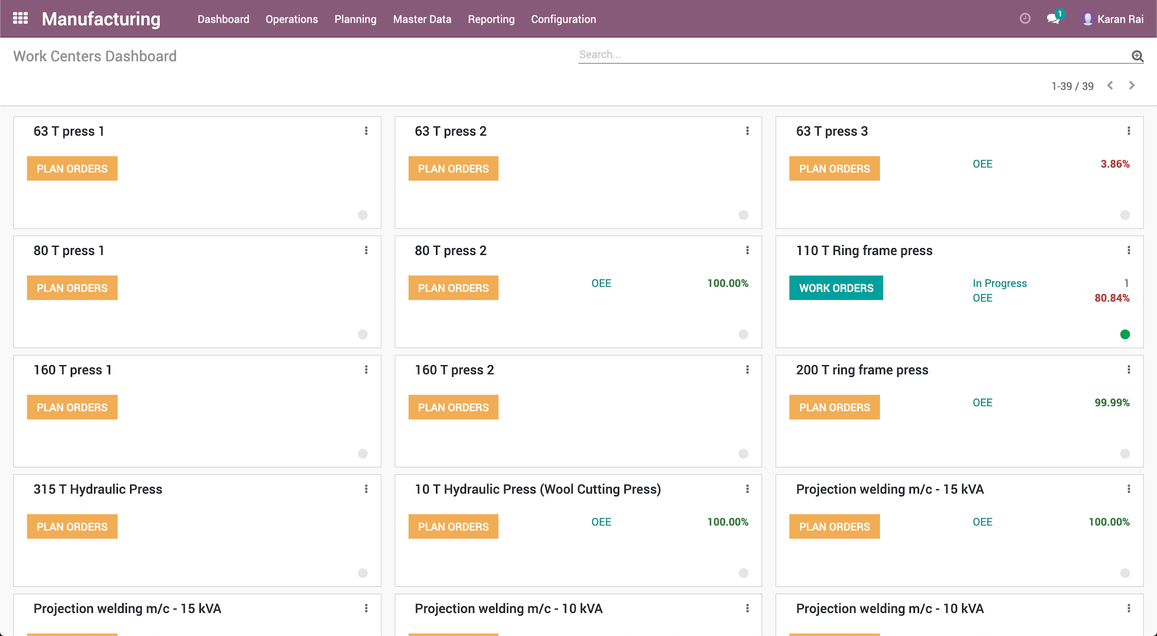
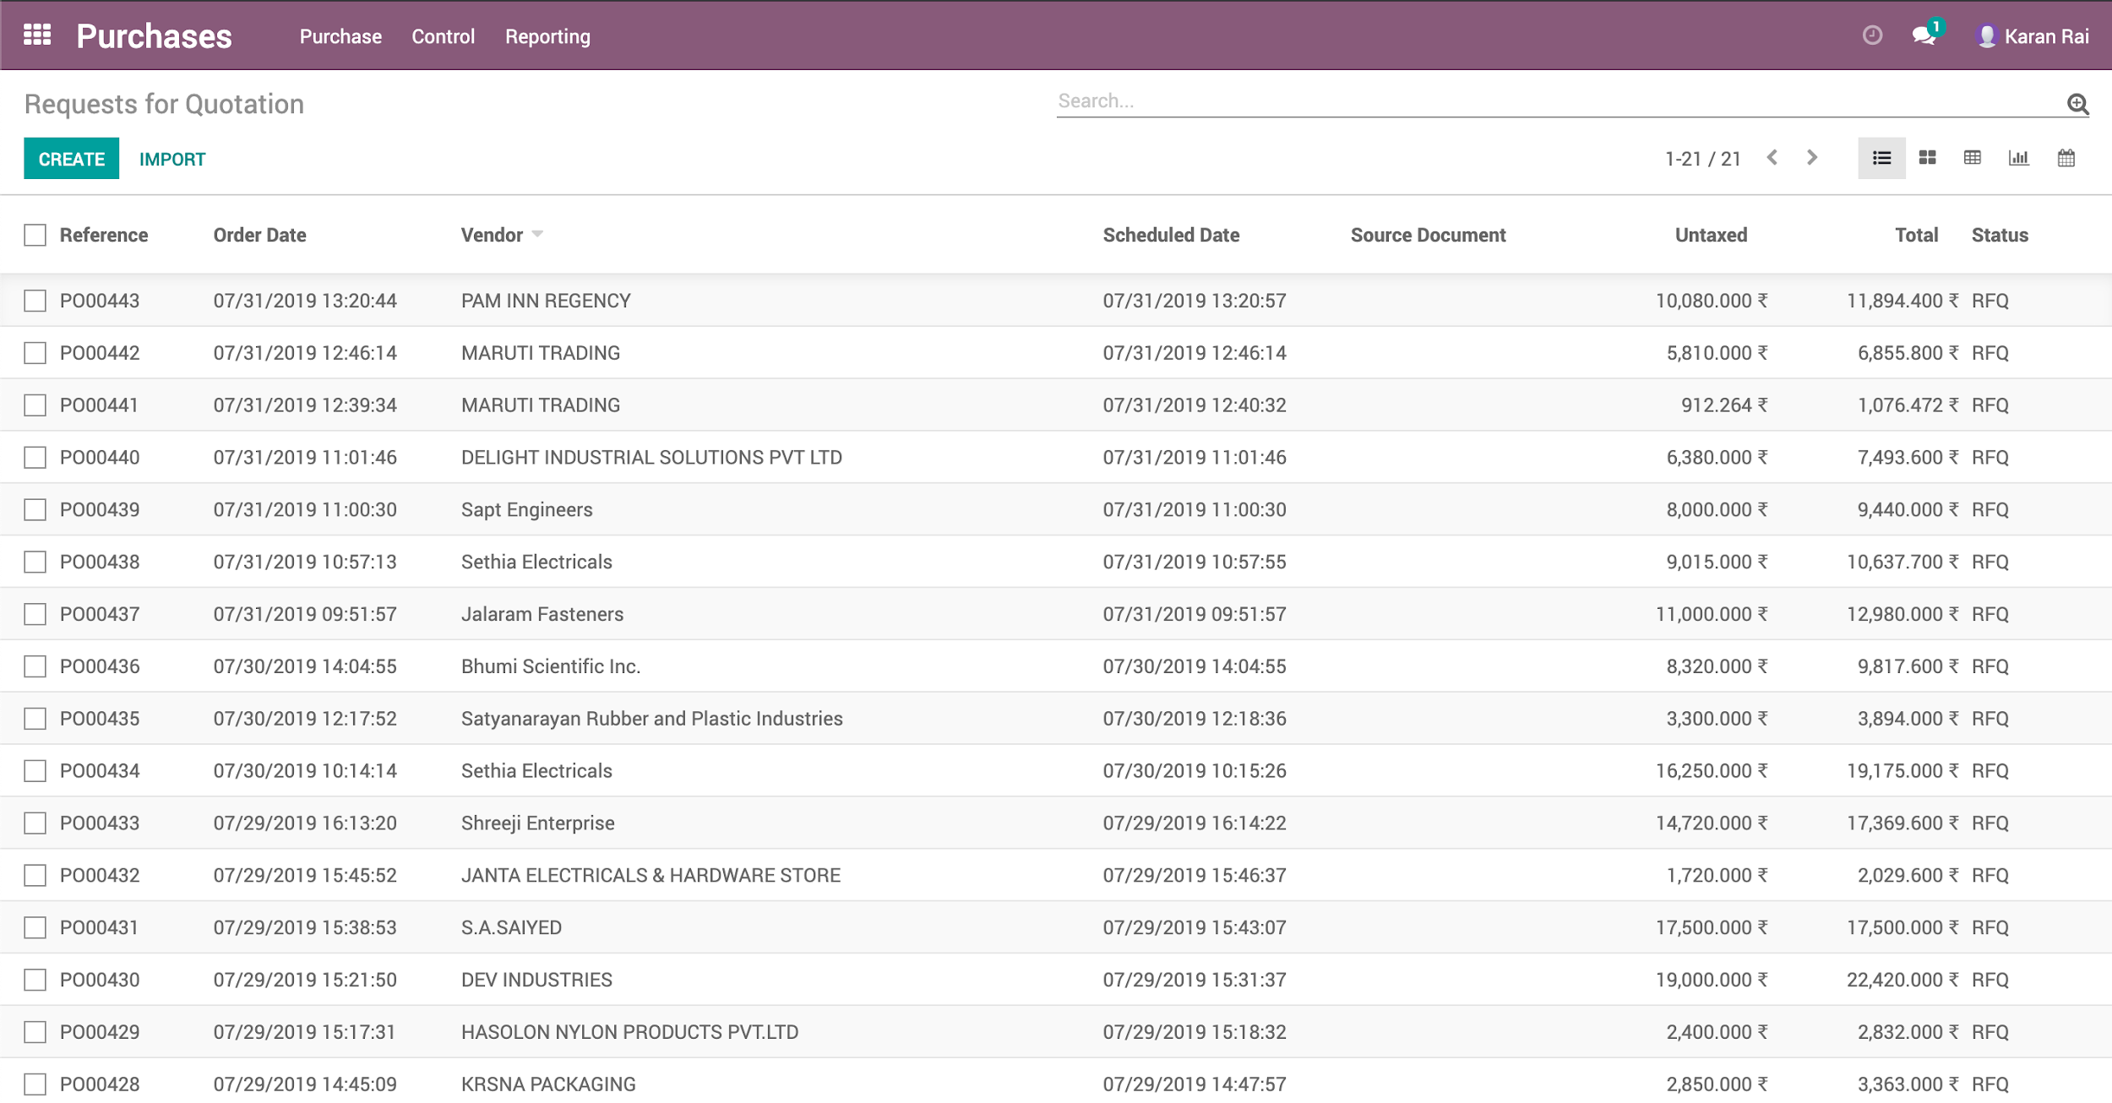

Slide 14
KSPS
Overview
KOKO Settlements and Payment System (KSPS) is a smart, scalable and robust solution to automate accounting and financial transactions for, and monetary flows related to transactions involving KOKO partners (Consumers, KOKO Agents and B2B partners) on KOKO’s smart urban commerce platform. It is an automated financial system, which enables the creation and posting of financial entries. The system efficiently manages various types of customer transactions which originate from the MyKOKO and the KOKOpoint applications to accurately record and process a high volume of daily transactions on a real time basis in accordance with various business and tax compliance rules. Transactions managed in the KSPS platform include:
Consumers: Top ups, Credit Transfers, Stove Sales and Fuel Purchases.
Agent Partners: Agent Economics management (Commissions, Advertising Fee and KOKOpoint Machine Fees).
Wholesale Partners: Fuel Price Management, Fuel Purchases and Technology Platform User Fee.
KRA tax compliance: VAT, Withholding Tax.
Payments: Settlement Reports and Bank Integration for payment release.
KOKO Digital Media: Sales and Invoicing.
System/Solution
The solution is built on top of Odoo 11 ERP (Accounting module) and seamlessly integrates with our KOKO Core system. KSPS allows for the tracking of Fuel Purchases, Fuel Sales, Stove Sales, Top Ups, VAT, Revenue Collection. KSPS also feeds reporting dashboards for our Insights package to provide a real time view of activities across the business.

Slide 15
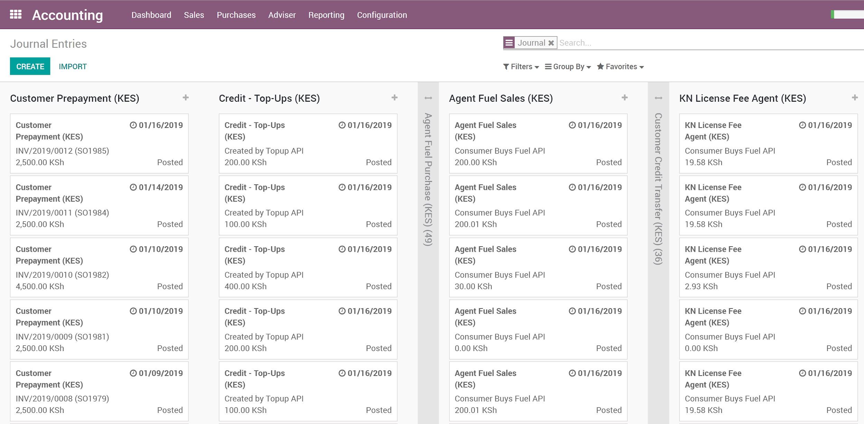
KSPS
Automated Financial Entries
Real Time Transactions
Real Time Postings

Slide 16
Cooker Kit Distribution & Maintenance
Overview
Cooker Distribution is managed by the KOKO Cooker Distribution apps which ensure Cooker Kits are delivered to KOKO agent locations in the most optimised and cost effective manner. The solution enables Inventory management, Fleet Management and Route Planning for deliveries and pickups. KOKO Agent locations are setup as warehouses in the system with predefined threshold stocks in the Inventory Management system. When a location falls below minimum stock an automated restocking request is generated to the main warehouse. Route Planning prepares a set of delivery schedule to optimise for cost and capacity. Fleet Management module enables the assignment of vehicles which are used to deliver Cooker Kits and tracks the deliveries in real time. Once the trips have been defined the warehouse team loads the required quantities cooker kits into the assigned vehicles using the Warehouse and Loading mobile app. KOKO Mile mobile app is then used to navigate and deliver cooker kits to KOKO Agent locations. The kits are scanned using the app and the agent signature and photo is captured to confirm delivery. The trips can be monitored and viewed on the KOKO Live Tracking feature which provides real time information on the route used by the vehicle and the waypoints planned for a trip.
System/Solution
This solution is built on top of Odoo 11 ERP and integrates with LogiNext and the proprietary Warehouse, Loading/Unloading and KOKO Mile mobile apps. The Android applications are native android applications, optimised for the range of phones commonly available in the region. A scheduler runs at the end of every day, which sends orders and available vehicle information to LogiNext (Route, Capacity and Cost Optimization). LogiNext considers all the parameters and shop GPS locations to create optimized Cooker distribution trips.

Slide 17
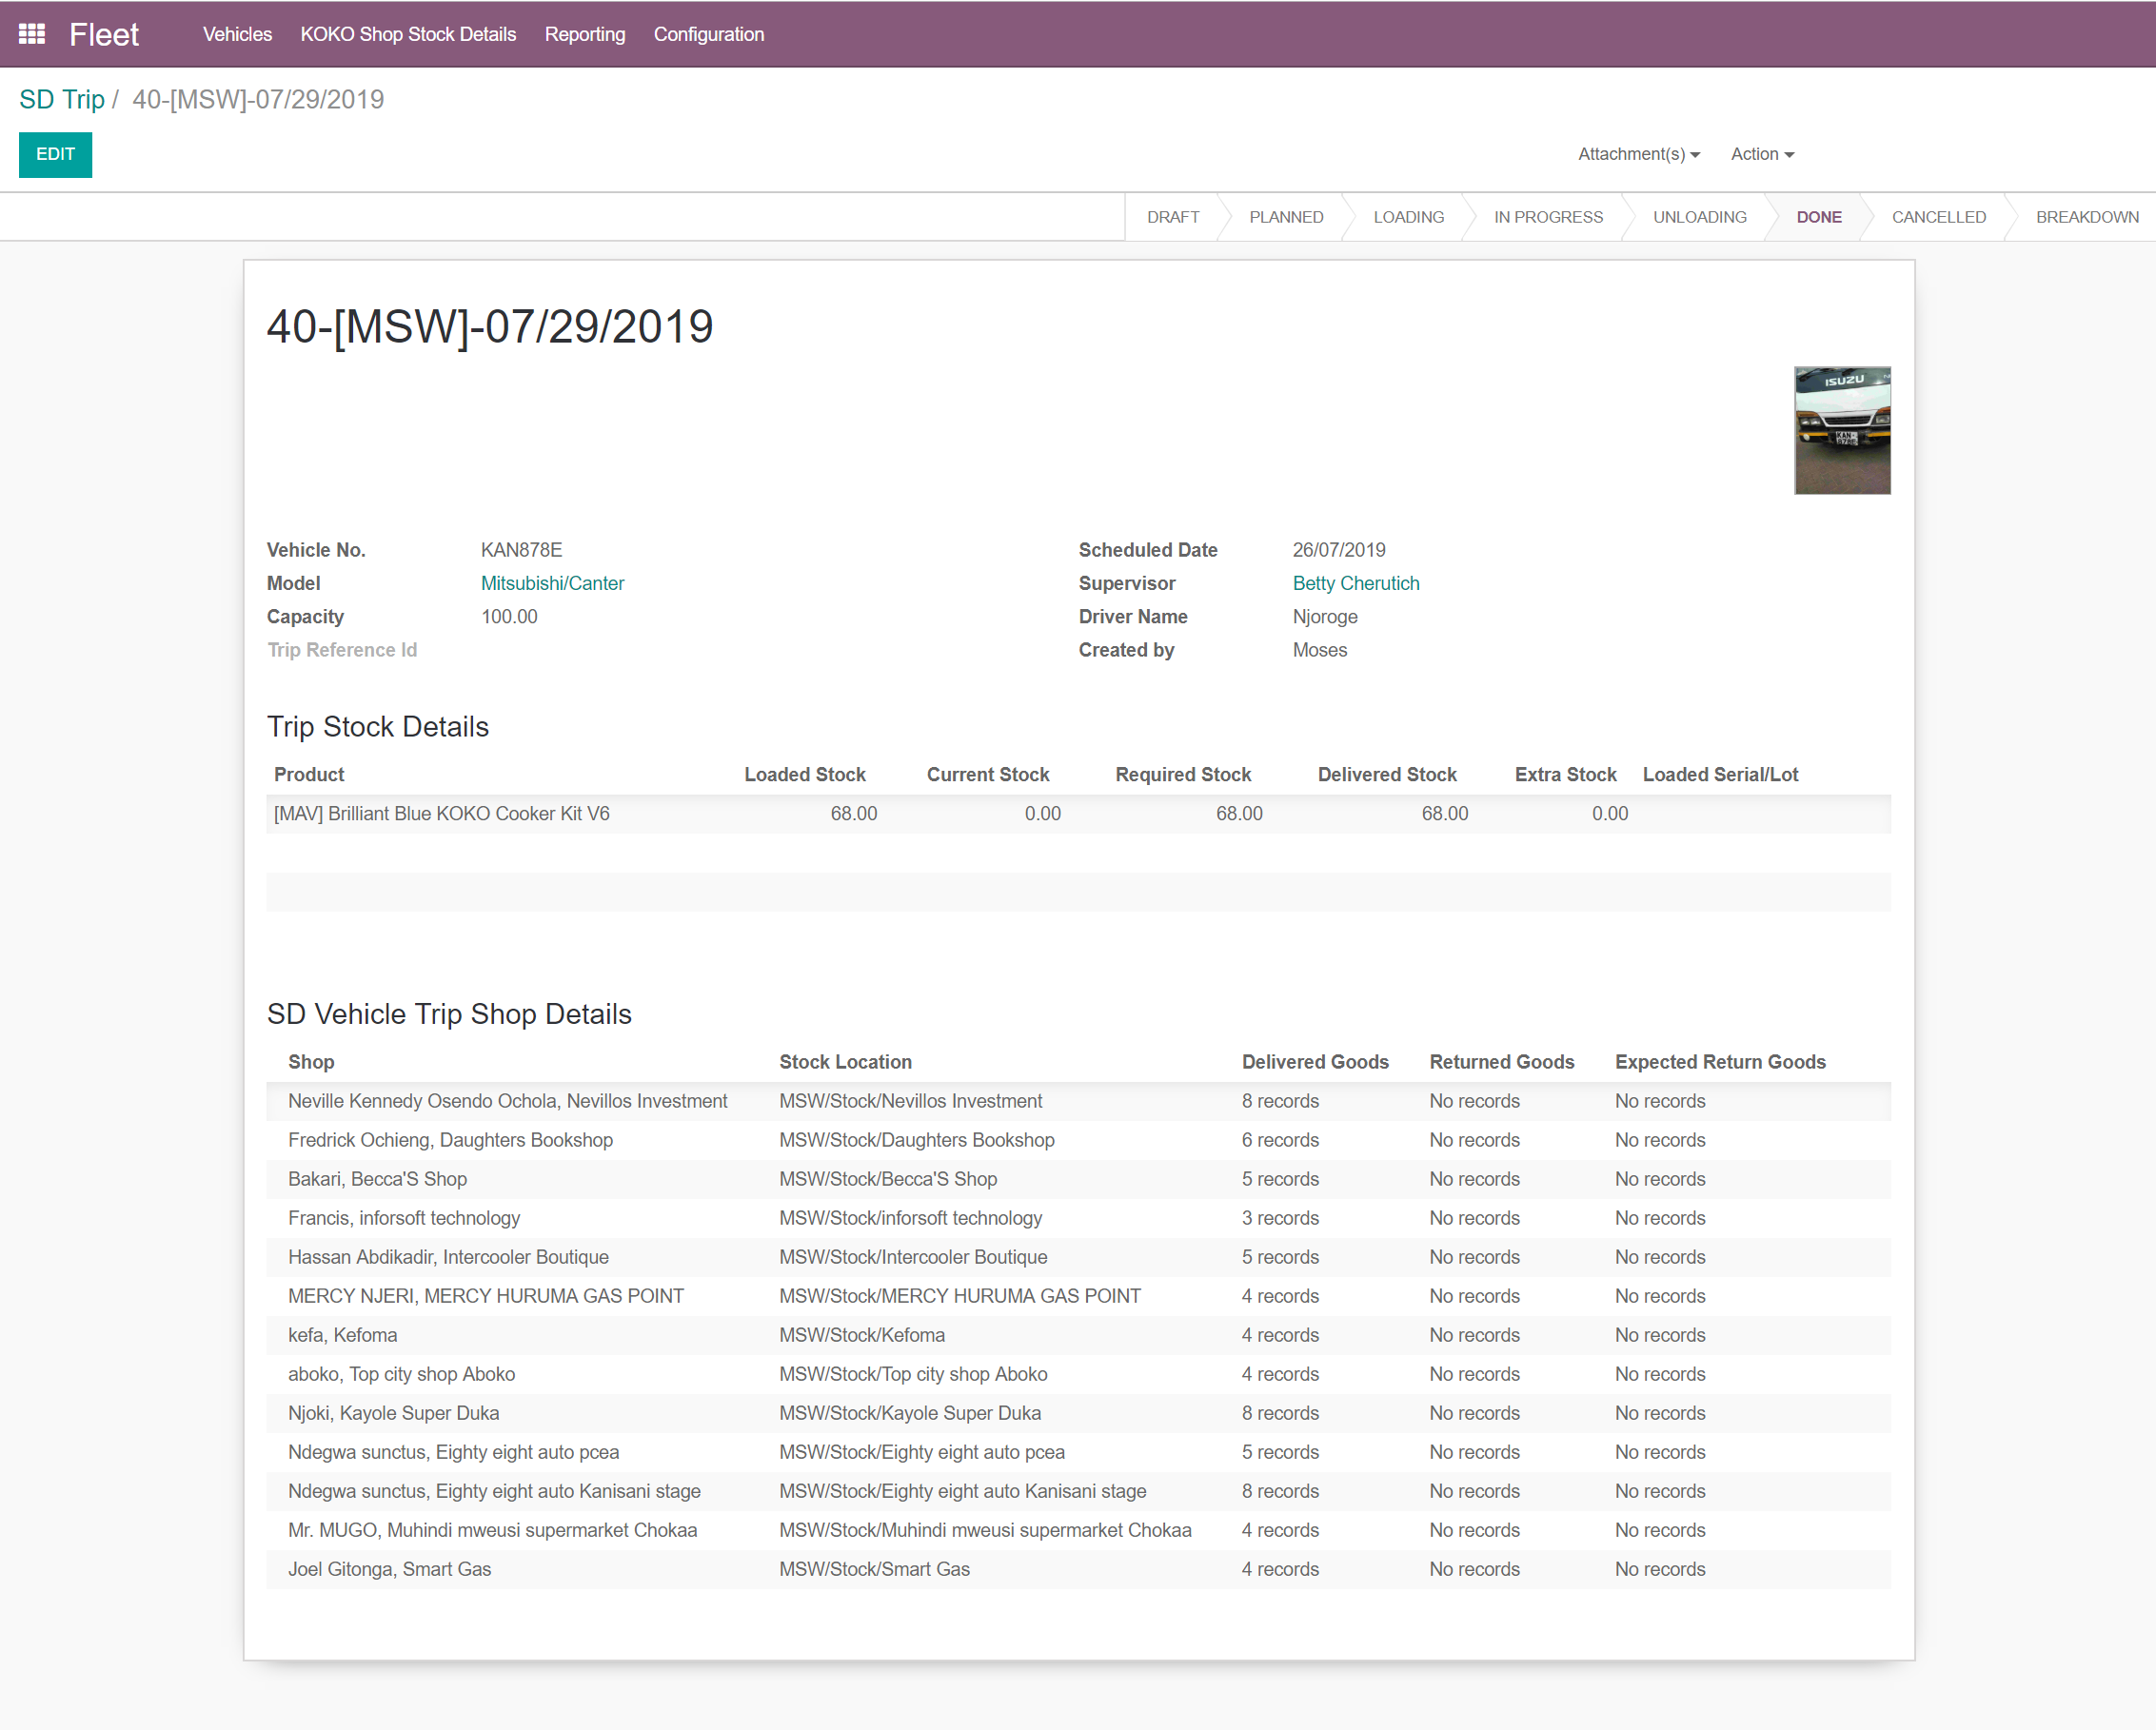
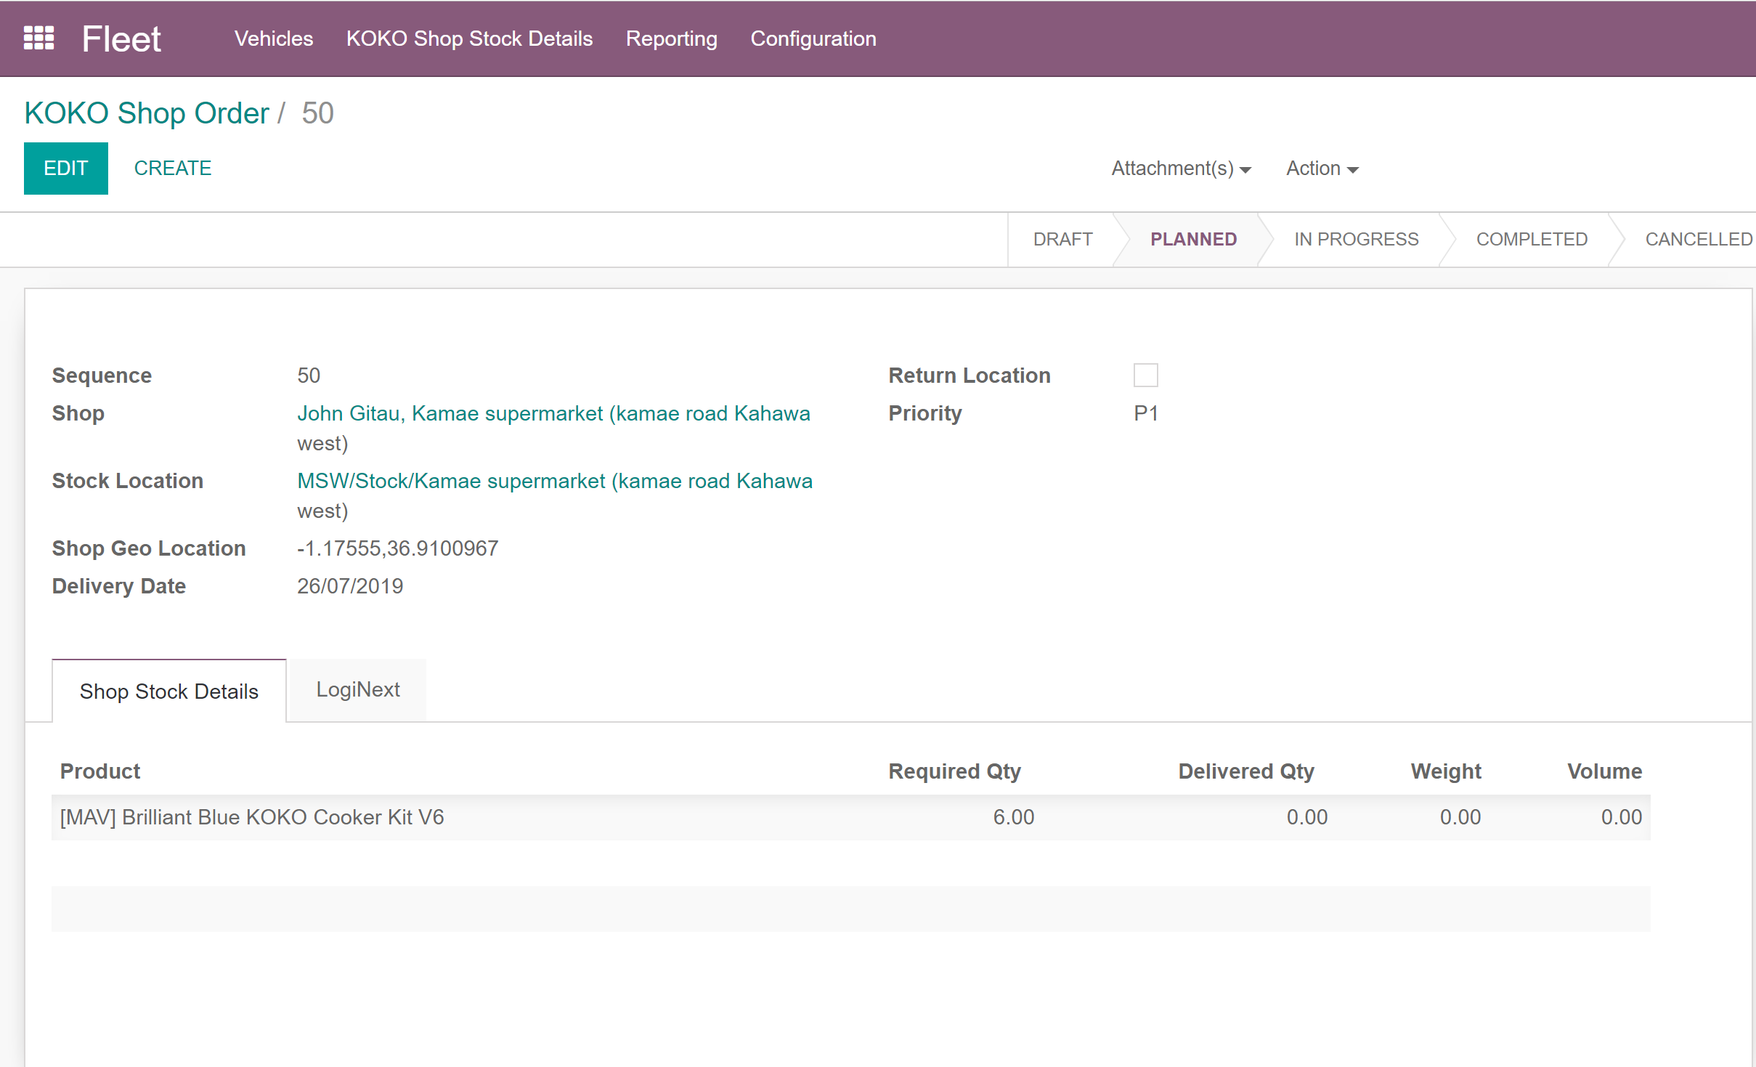
Cooker Kit Distribution & Maintenance

Slide 18
Fuel Logistics
The fuel logistics platform allows KOKO’s downstream fuel distribution partners to manage the delivery and sale of ethanol cooking fuel to KOKO agents in a completely automated secure and safe fashion.The system is designed to give the wholesaler partners complete visibility of the current live fuel state across the network, distribution operations as they happen in real time and a history of all fuel transactions in the network. The system is also designed to give our wholesaler partners a guaranteed payment for fuel as soon as the delivery has been confirmed by KOKO’s systems
The fuel logistics platform consists of three main systems that are involved in the fuel delivery operations
Smart Depot System(SDS): A bolt-on-kit in existing petrol station storage infrastructure provided by our Fuel Supply partner that manages the fuel deliveries to the Microtanker.
Smart Tanker System (STS): A bolt-on kit, that can be fitted onto any approved fuel transport vehicle. The Smart Tanker System has a proprietary embedded control system, designed and built by KOKO Networks which manages the dispense of fuel into KOKOpoints using industry standard fuel delivery equipment. In addition, it tracks the Tanker’s location continuously and monitors the vehicle’s fuel payload at all times.
KOKOpoint: The KOKOpoint is a secure, online and remotely monitored self-service kiosk, which dispenses KOKO Fuel. It has a proprietary embedded control system, designed and built by KOKO Networks which manages the dispensation of fuel to customers and monitors the system’s safety and security.
The entire process is:
Planned and Managed on the Distribution Control Center: A web application allowing the configuration of all of the fuel systems and users and providing live control and monitoring of the delivery process from the Depots to the KOKOpoints in agent shops via the MicroTankers.
Executed by using the KOKO Operator App:An android app used by KOKOpoint refilling operators to support the smooth execution of a set of KOKOpoint refills. In addition, it permits keyless unlocking of KOKOpoint access boxes for refilling using GPS based location matching of the operator and Smart Tanker System.
Orchestrated on KOKO Core: Cloud based system that manages the state of the entire refills process and orchestrates the communication between all of the IOT devices in our fleet.

Slide 19
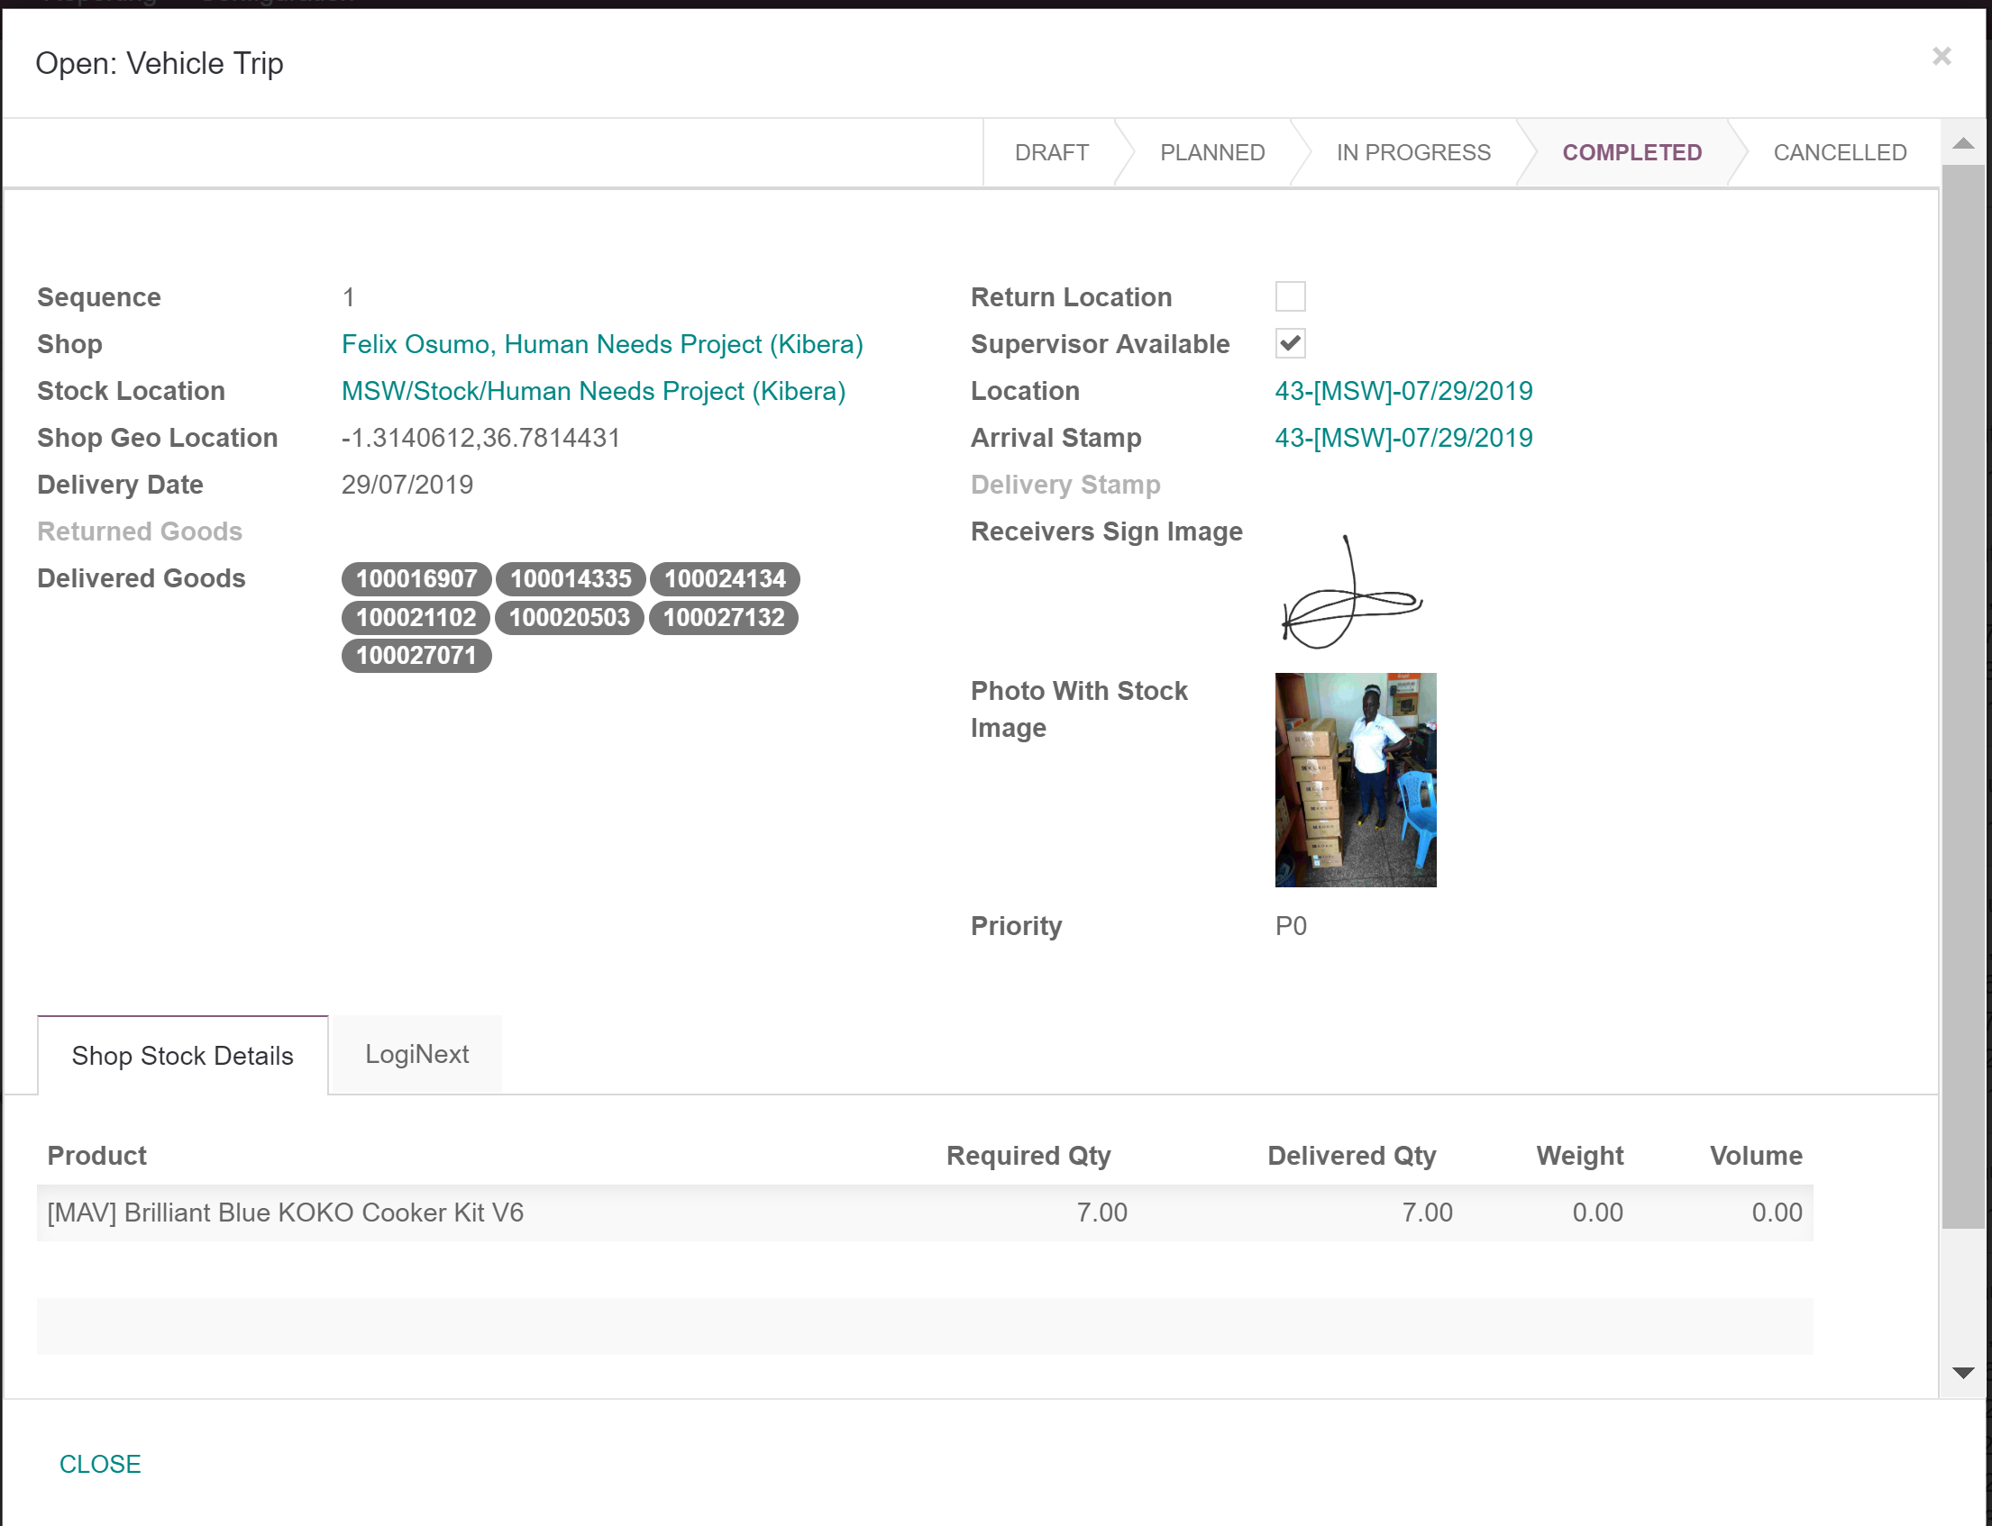
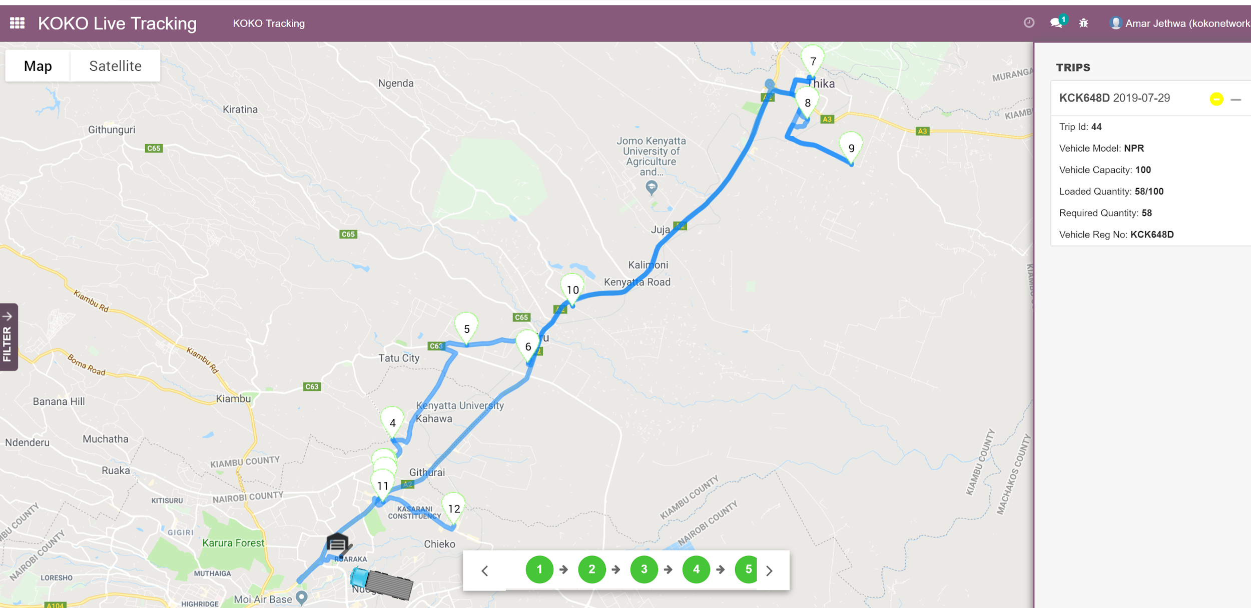
Cooker Kit Distribution & Maintenance

Slide 20
Fuel Logistics: Features 1
Smart Depot System
Screenshot: photo of depot
Features:
Dispense KOKO fuel to Micro Tankers
Monitor fuel levels at all times
Monitor environment and telemetry at all times to ensure safe operations
Smart Tanker system
Screenshot: change photo to include latest ones
Features:
OK
KOKOpoint:
Screenshot: Photo of KP
Features:
Dispense KOKO fuel to end user customers
Monitor fuel levels at all times
Monitor environment and telemetry at all times to ensure safe operations

Slide 21
Fuel Logistics: Features 2
Distribution Control Center
Screenshot: https://prod-ke.kokonetworks.com/admin/refilling/dashboard/13
Features: OK
KOKO Operator App
Screenshot: OK but change phone
Features:
Add: Geofence operator to the KOKOpoint location
KOKO Core:
Screenshot:
Features:

Slide 22
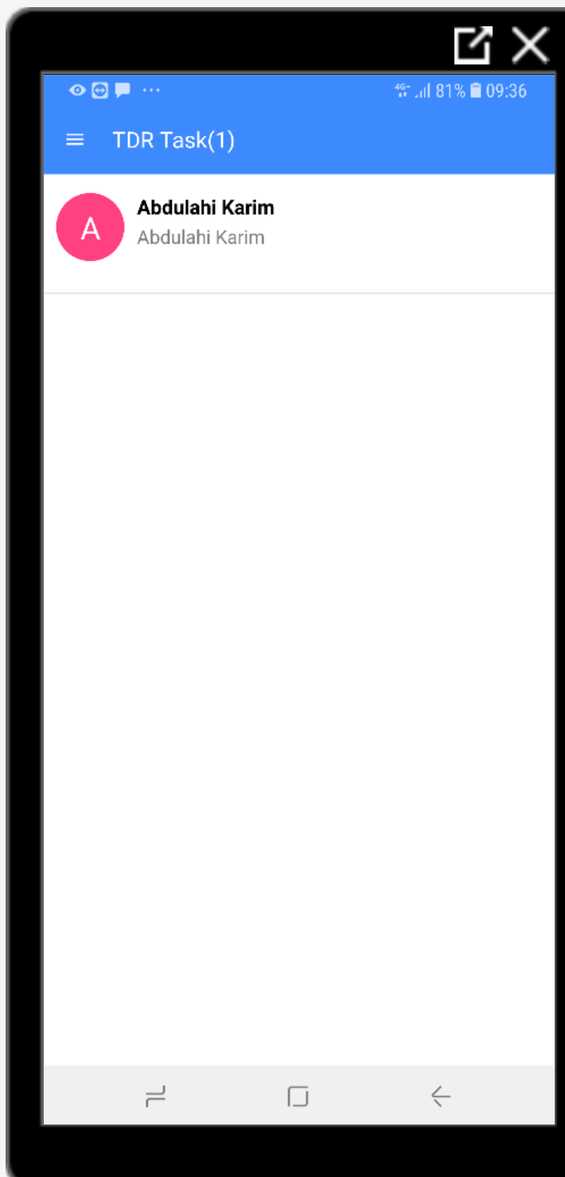
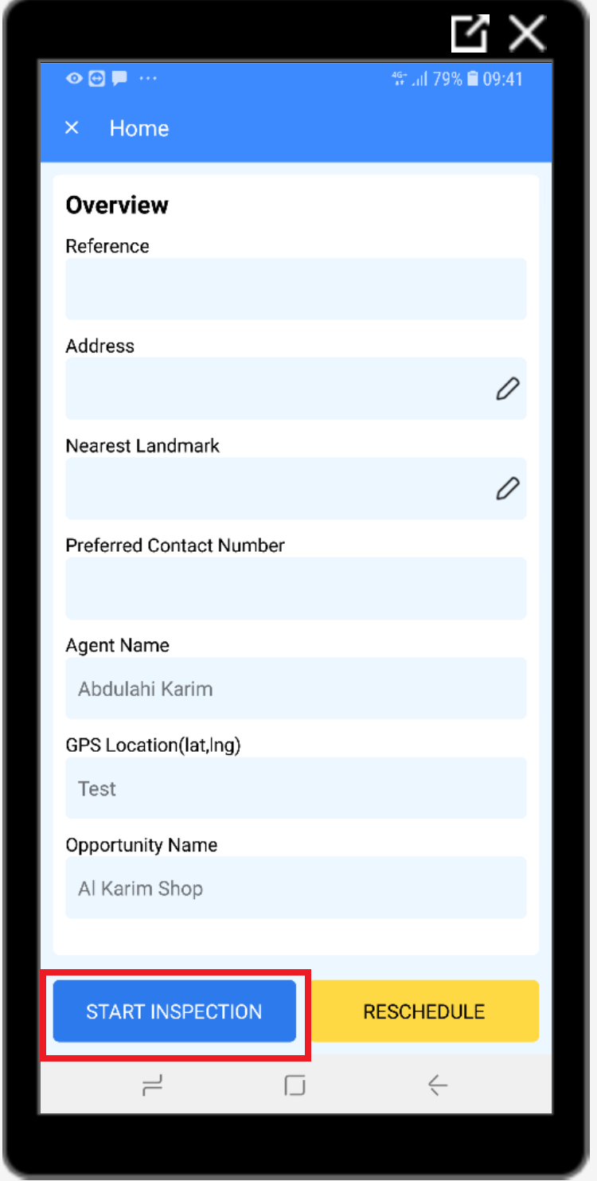
Agent Management
Overview
The Agent Management module is a customisable self service CRM tool which allows agent sales representatives to build an agent network from scratch. Right from first contact through to qualification, inspection, contracting and KOKO point installation and deployment, the sales representatives update the information about the agents and this information capture is facilitated using two mobile apps:
Agent Sales app: This app allows the sales representative to capture key information about the agent to help qualify them as they engage with them from time to time.
Agent Inspection app: Once the agent has been qualified, the inspection team can use this app to inspect the premises, suggest modifications and track the completion of these modifications to ensure the premise is fit for KOKO point installation.
All this information captured using the mobile apps and the Agent management web app is maintained as lifecycle notes tagged to the agent as they progress through various stages in a pipeline. Each stage contains specific business rules to ensure the relevant information on opportunities is correctly collected at the right stages and that the location is feasible and attractive for the business. The system also tracks deposits made by agents which are automatically tagged against them as they pay using mobile money.
New / Qualification / Pitch / Inspection / Contract / Modifications / Installation / Won

Slide 23
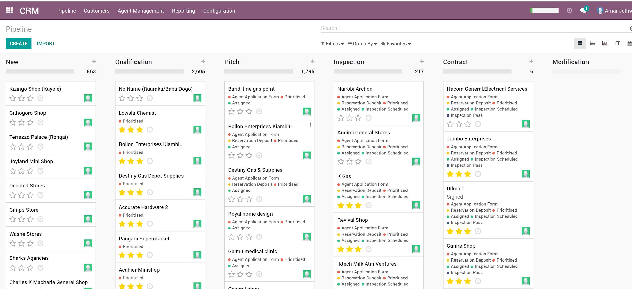
Agent Management
Clearly Defined Stages
Opportunity Overview & Tags showing achieved milestones
KP Location Priority (Low, Medium & High)

Slide 24
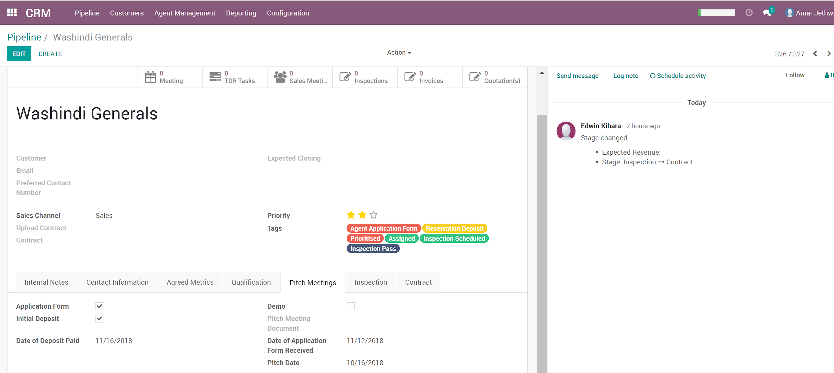
Agent Management
Manage Changes and Communication on a Single System - Odoo CRM
Get the right data the right way - TDR Surveys and Agent Site Inspections

Slide 25
Insights
Our Insights platform is a Big Data Solution that allows us to transform the millions of data points that we collect each day and transform it into real time operational interventions as well as informing strategic business decisions. Our technology choices in this area seeks to minimize the long term costs typically associated with such a platform as well as maximize insights and data access to the people and teams best equipped to act on it.
This is broadly categorized in 3 main areas,
Store and Transform: We collate and aggregate millions of data points each day from all of our field IOT systems, customer interactions with our online tools. We store this data over a range of technologies and transform it using managed ETL solutions and some of our own custom applications.
Presentation:We typically use all of this data to build out visualizations on a range of tools depending on the business need.
Cloudwatch: Used by the technology team to monitor the state of our managed cloud infrastructure
Grafana: Time series visualization and alerting tool used by the technology team and operations teams to understand the live state of our network
KOKO Admin: Visualization of data mostly coming in from the fleet of our field IOT systems (KOKOpoints, STS’s, SDS’s)
Tableau: BI tool used to visualize business dashboards and is used mostly by business operations teams to understand KPIs
Geckoboard: Drives most of our the wallboards that highlight key business OKRs
Action: After we have these insights, we typically create both automated and manual interventions for operational processes. We also use this data to drive strategic business decisions

Slide 26
Insights - product showcase
Grafana
https://status.kokonetworks.com/d/lBlZLEkZk/kps?orgId=1&refresh=5m&var-kpid=100
https://drive.google.com/open?id=1O3KZswO4itENxkBIxPhiPe6XC0fOaX7I
Tableau
http://tableau.kokonetworks.com/#/views/Operations-Fuel/DepotCompletedRefills_1?:iid=1
https://drive.google.com/open?id=1xfxGObpaVszBbM6GptnMU6M0-LSCXi_v
Geckoboard

Slide 27
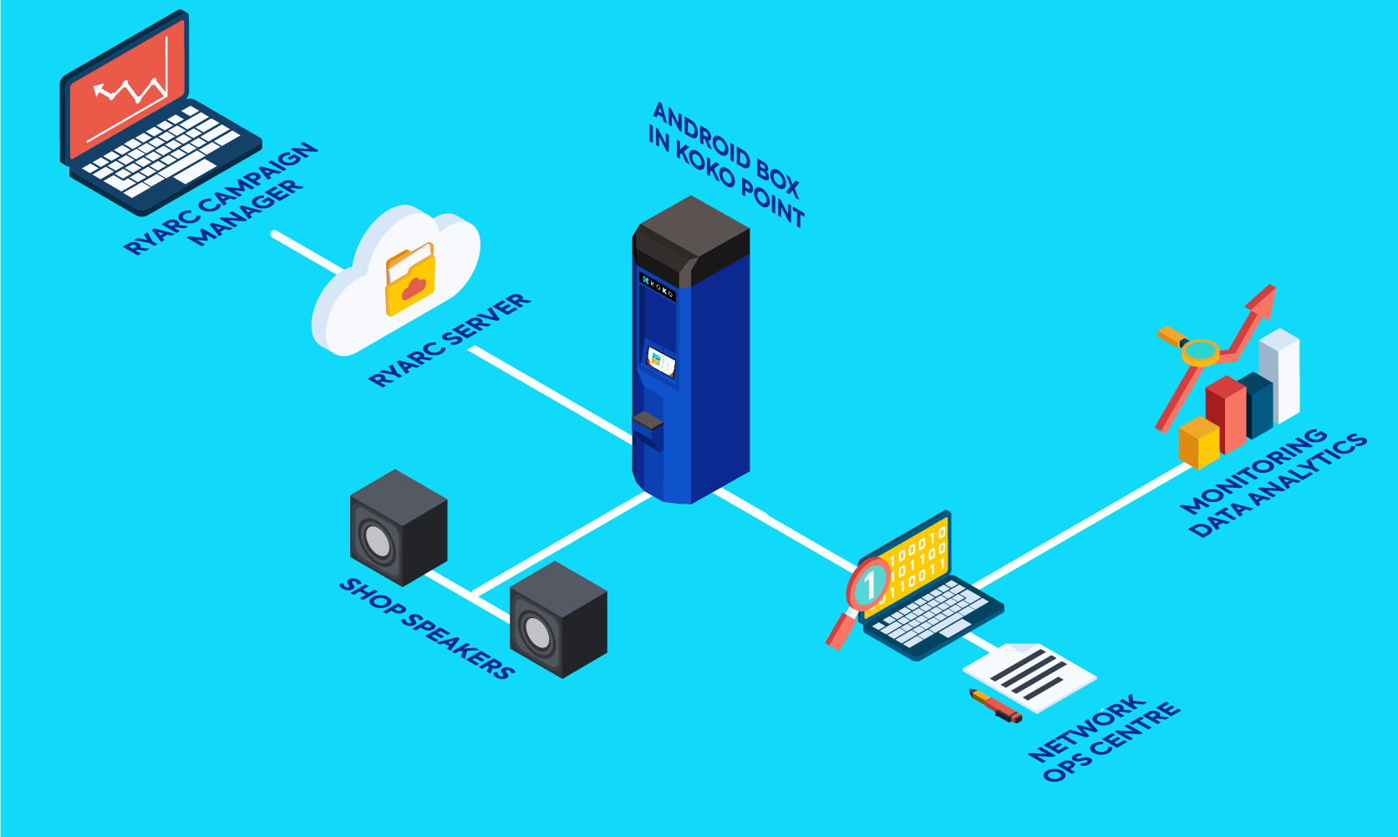
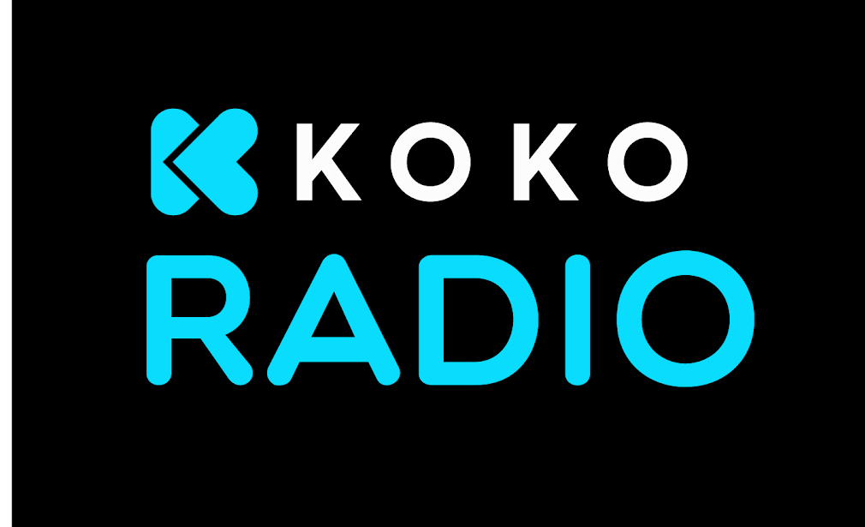
KOKO Radio
KOKO Radio is a web based radio station that is run via a cloud application and identifies each shop as a separate unit. It is 14 hours of non-stop music with Ads stitched in between to promote brand consideration, product recall and actual sales, all at once at the point of purchase.

Slide 28
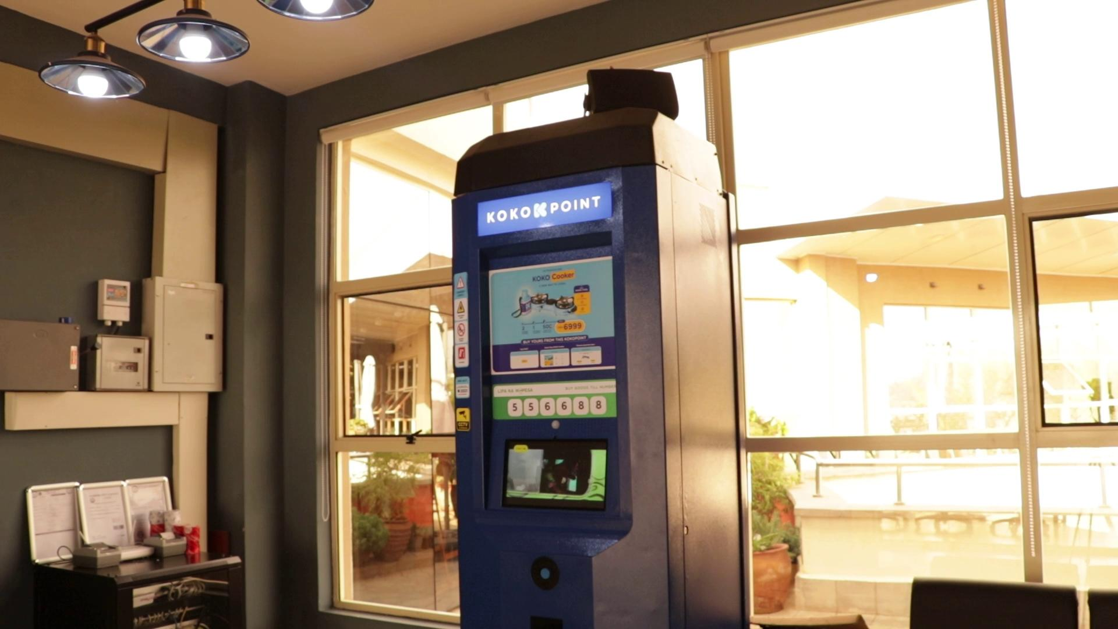
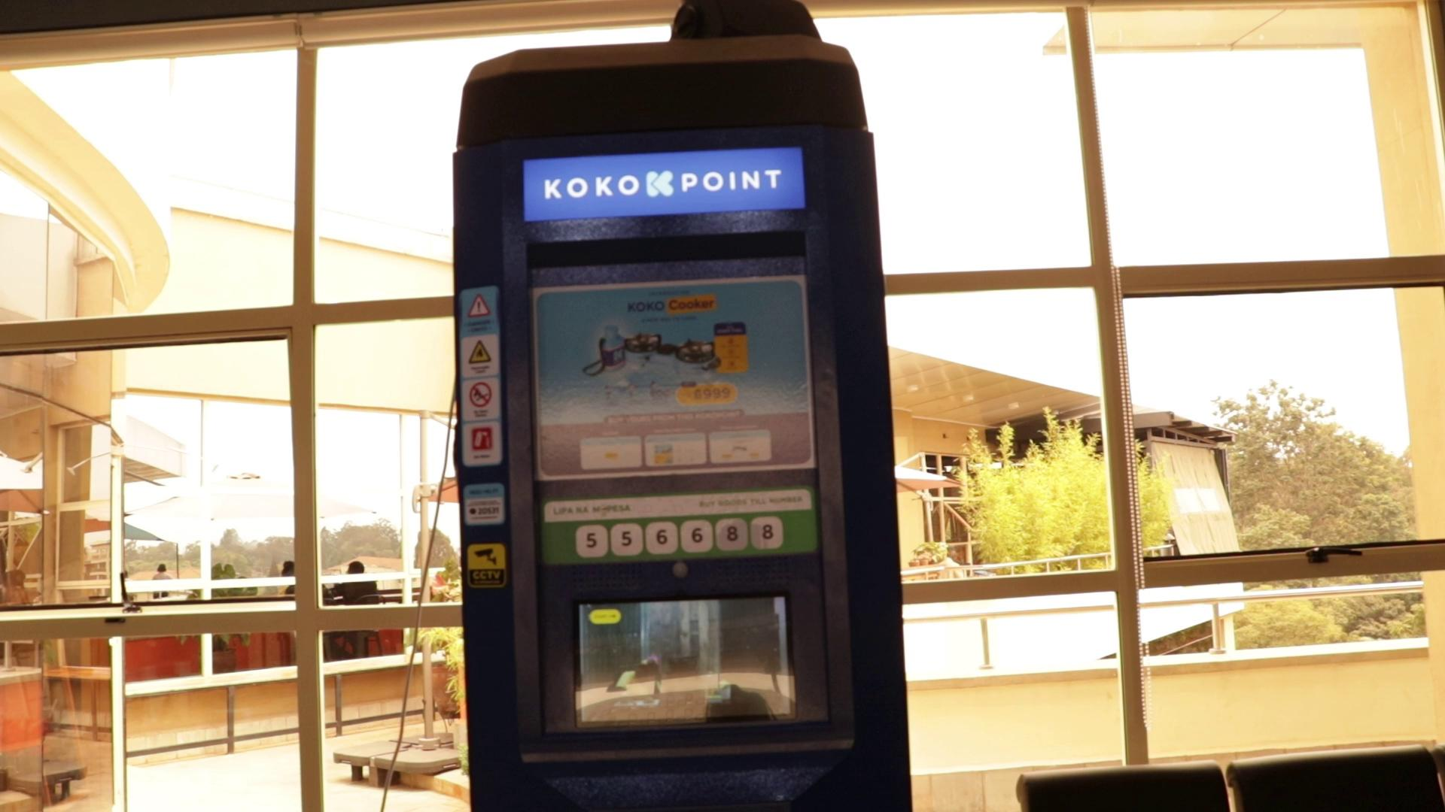
KOKO Radio in Action
KOKO Radio News
KOKO Radio Music + Ads

